Slide 1

How do casinos make money
Yash Sindhu
J061

Slide 2
Introduction
A major part of a casino’s income comes from the various games they play.
Each and every one of their games is based on probability.
Slot machines are the most profitable sources of income for a casino.
Good strategies help the casinos earn more money by taking advantage of people.
I have attempted to run simulations to demonstrate how casinos earn money through slot machines and roulette, their most popular games.

Slide 3

Games
Slot Machines
Poker
Roulette
Blackjack
Baccarat
Bingo
and several other table, machine and random number games.

Slide 4

Slot machines
The easiest and the most popular game of the casino
Casinos have an average return rate of 89%.
For my slot machine, the return rate will be set at 90%.

Slide 5

Assumptions
Suppose there are 200 spins every hour for 12 hours of the day.
Which amounts to 2400 spins a day with a bet ranging from 5$ to 100$.

Slide 6
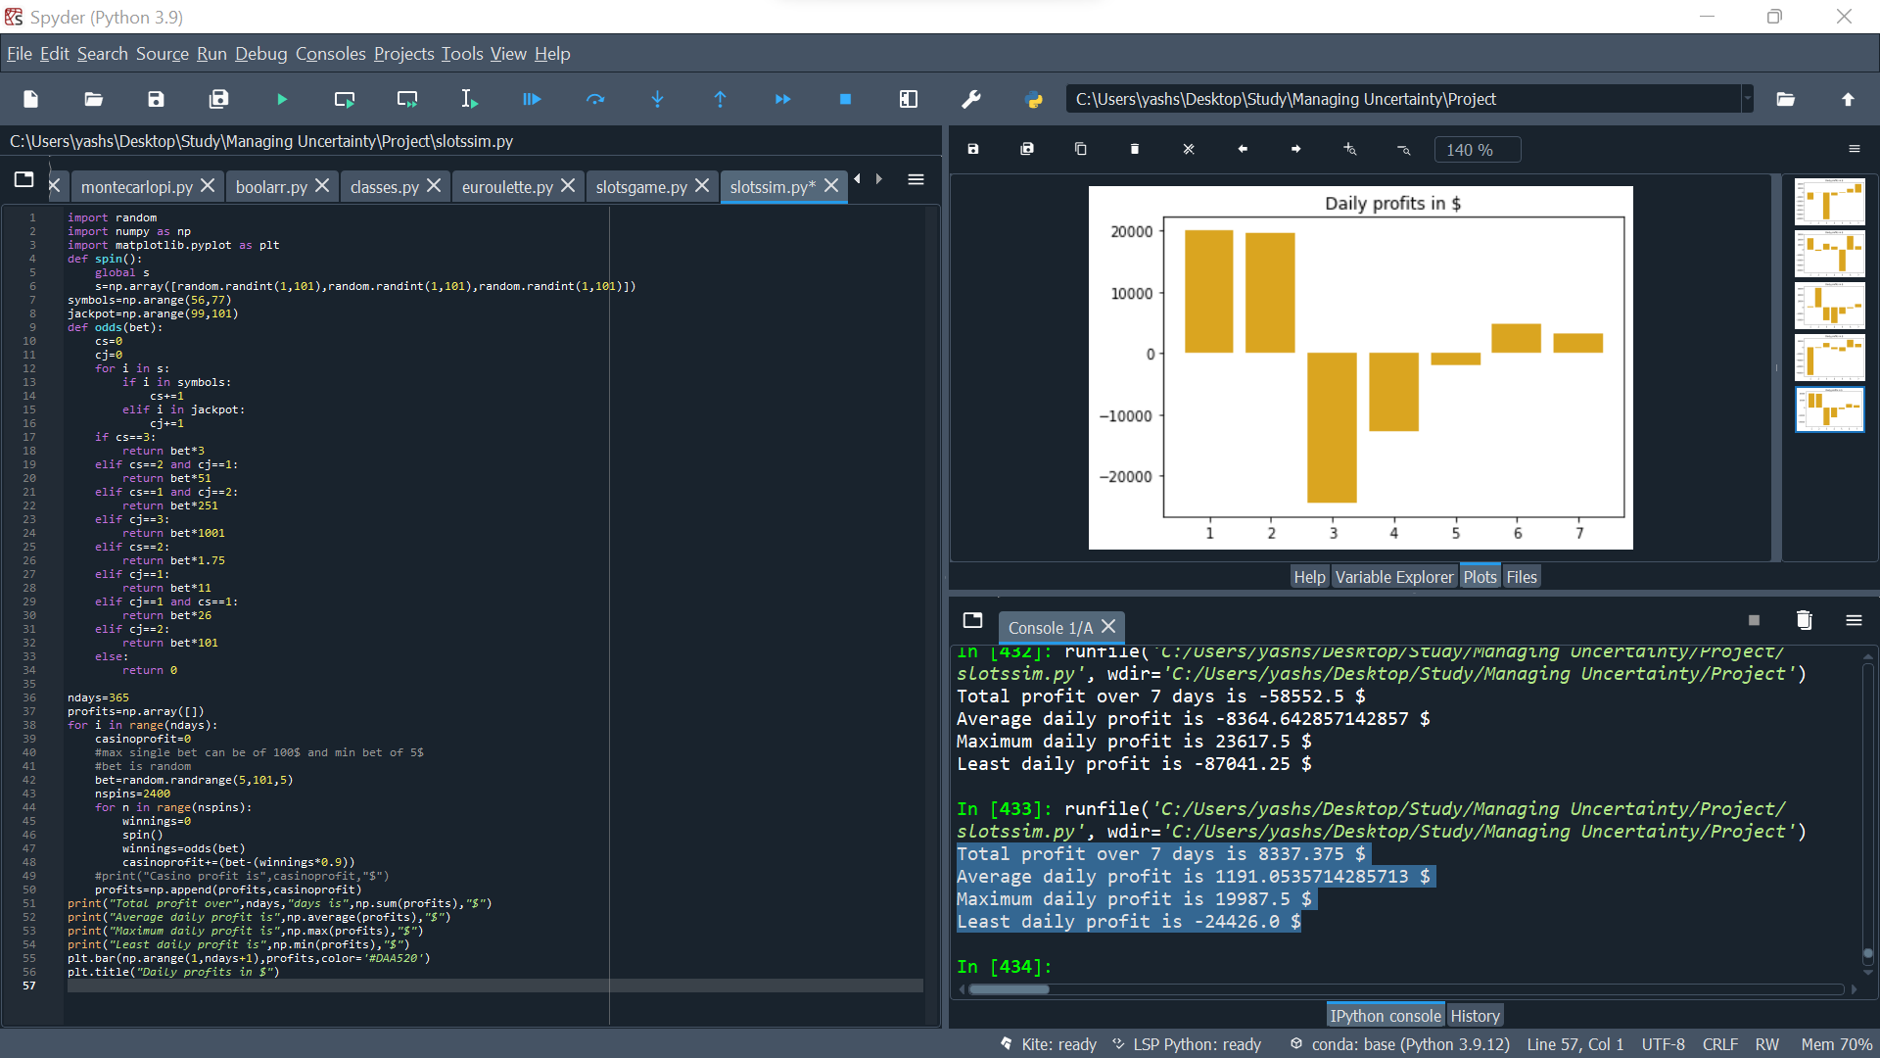
The simulation code

Slide 7
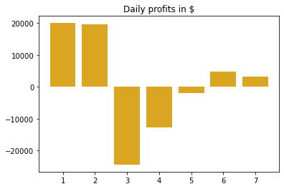
7 day simulation
statistics
graph
Total profit over 7 days is 8,337$
Average daily profit is 1191$
Maximum daily profit is 19,987$
Least daily profit is -24,426$

Slide 8
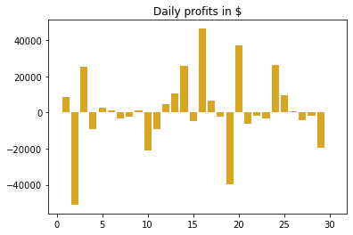
30 day simulation
statistics
graph
Total profit over 30 days is 28,627$
Average daily profit is 954$
Maximum daily profit is 46,488$
Least daily profit is -51,015$

Slide 9
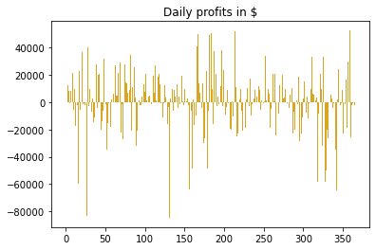
365 day simulation
statistics
graph
Total profit over 365 days is 113,378$
Average daily profit is 310$
Maximum daily profit is 52,663$
Least daily profit is -84,660$

Slide 10
Yearly profits for multiple machines
ONE: 295,530$
TWO: 999,802$
THREE: 789,129$
FOUR: 672,883$
FIVE: 373,099$
SIX: 485,686$

Slide 11
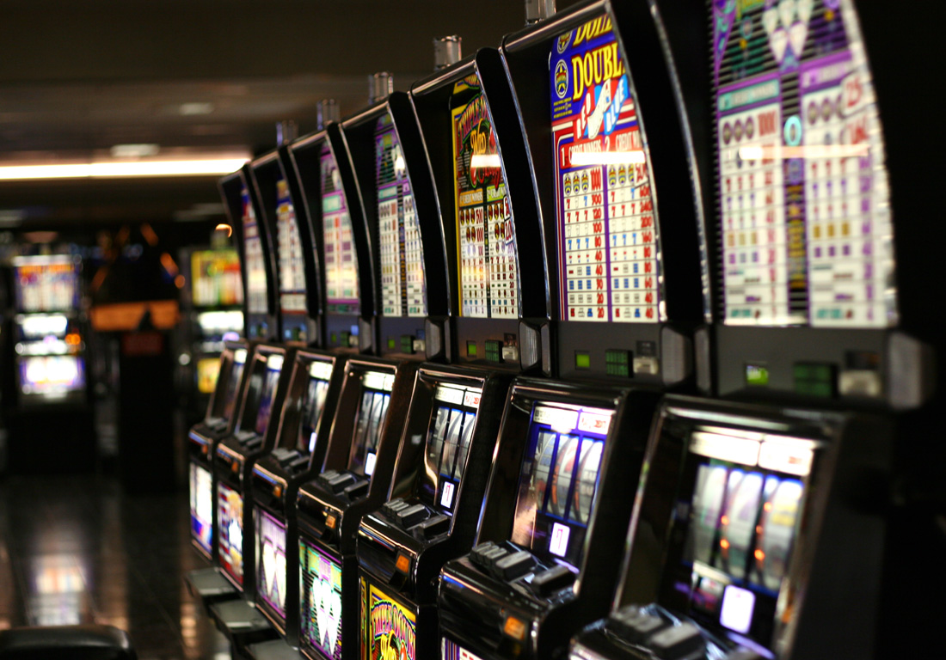
Money made
There are 500 slot machines on an average in a casino.
Each machine is averaging 650,000$ yearly profit.
Which means 500 of these machines make 325 million $ each year on an average.

Slide 12
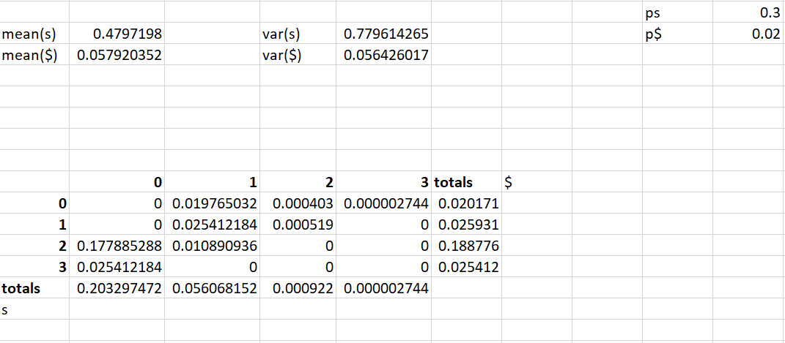
Odds of my slot machine

Slide 13

Roulette
The most profitable table game for the casino.
High return odds for the player.
The house edge for roulette is 5.2%

Slide 14
House edge
The only way to get 0 and 00 is by betting on them as individually.
This means they are getting paid for 36 numbers but they are playing against 38 numbers.
Hence, they are getting paid 2/38 (5.26%) less than they should.
For example, if you bet on the number being red, you aren’t including 0 and 00 thus losing out.

Slide 15
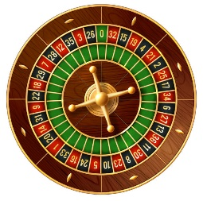
Assumptions
Upto 7 players can play at one roulette table.
Suppose there are 100 spins a day with a bet ranging from 5$ to 5,000$.

Slide 16
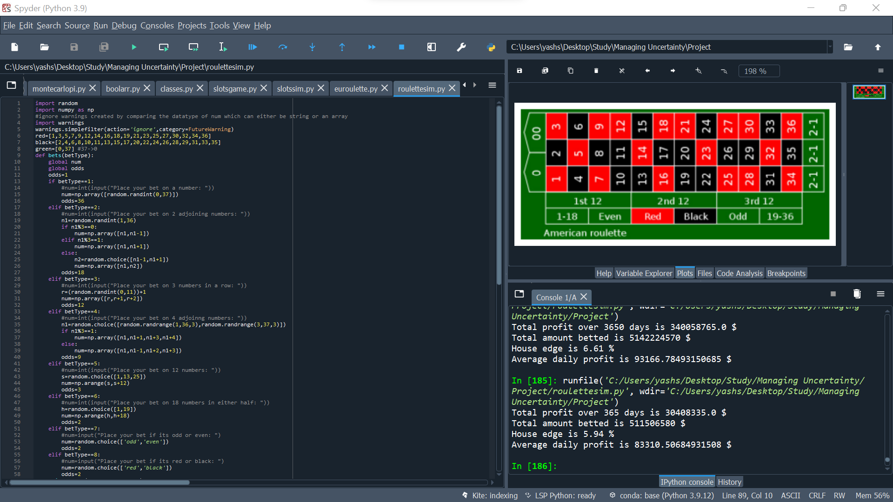
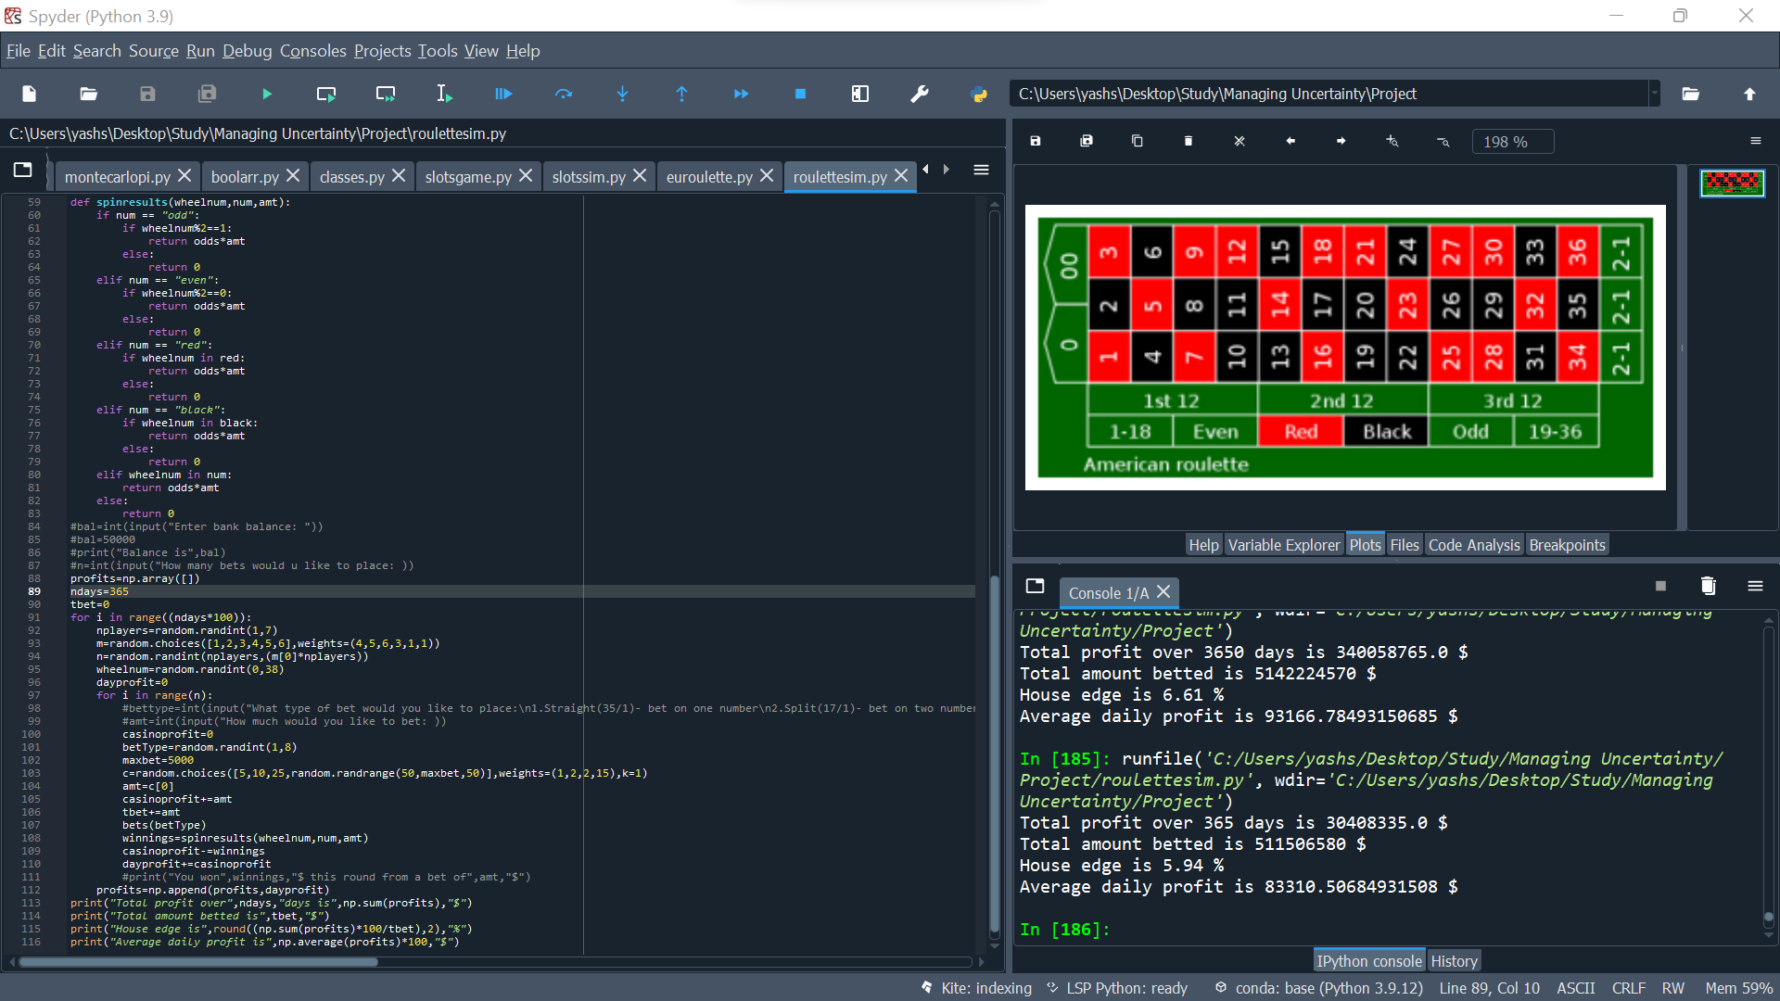
The simulation code

Slide 17

Roulette simulation
Total profit over 300 days is 23,369,220$
Total amount betted is 453,149,710$
House edge is 5.16%
Average daily profit is 77,897$

Slide 18
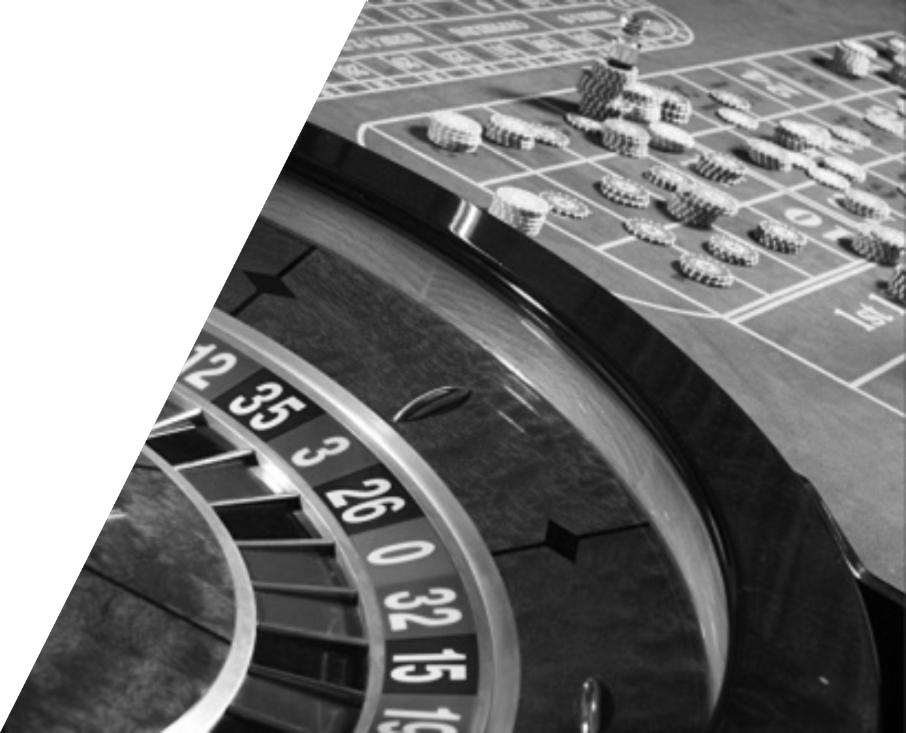
Money made
There are about 10 roulette tables in a casino.
That makes a profit of 300 million $ from roulette tables per year from my simulations.

Slide 19

Conclusion
Casinos always end up making money in the long run.
Winning money in casinos is not likely and you should stick to games like blackjack if any where your odds of winning money are better.

